Slide 1
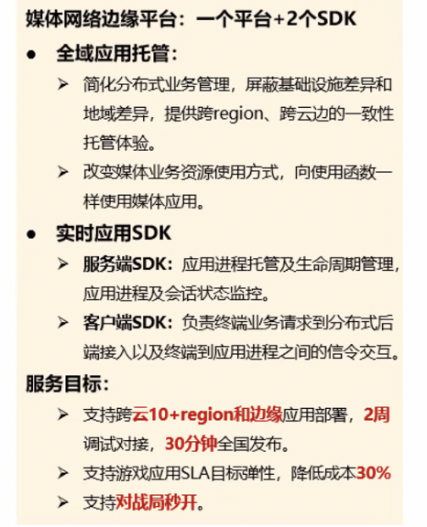
全域应用的托管平台
APP
“全域”-> Regionless
“应用托管”-> Application Hosting
APP
APP
DB APP
DB APP
APP
DB APP
Regionaless Hosting Platform
Region A
Region N
Region B
Edge Sites
CDN Sites
Use Cases
Requirements
Design Thoughts

Slide 2
Use Case 1
Region 1
Region 2
Region 3
Stateless CP
Stateless CP
Stateless CP
Workloads (pods, deployments, etc.)
Nodes
VPC, Subnets
…
etcd
etcd
etcd
R2
R3
R1
Use Cases
Requirements
Design Thoughts

Slide 3
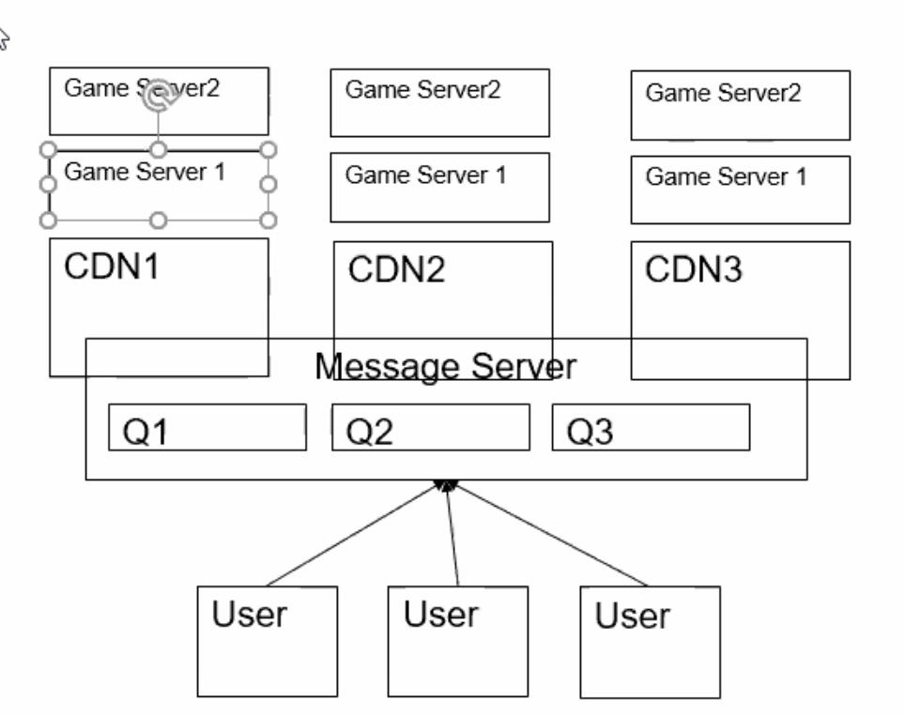
Use Case 2
Region 1
Region 2
Region 3
Game Instance
Game Instance
Game Instance
Game Instance
Game Instance
Game Instance
Original sketch by Fei
Game Instance
Game Instance
Game Instance
”pub”
Topic X
Topic X
Topic X
radis
radis
radis
Topic Y
Topic Y
Topic Y
”sub”
Client 1
Client 6
Client 2
Client 5
Client 3
Client 4
Use Cases
Requirements
Design Thoughts

Slide 4
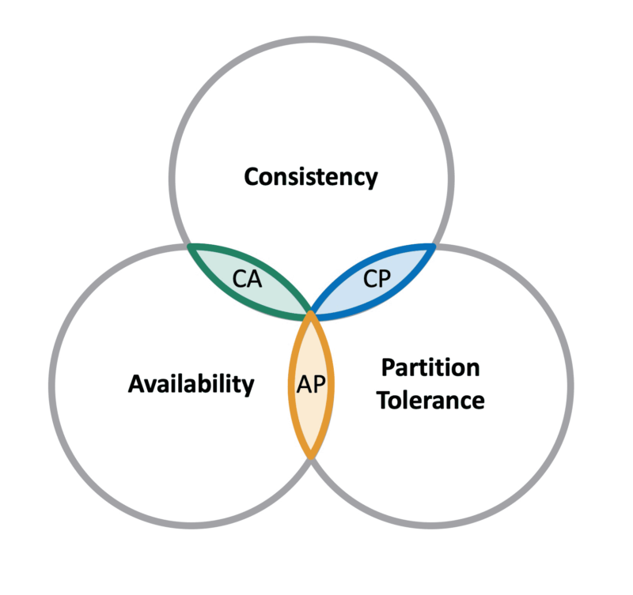
Key Requirements
Performance
Latency
Throughput
Capacity Limit
partition vs full copy
Unified Storage API compatibility
e.g. etcd list-watch
KV put/get
Message Queue pub/sub
Fault Tolerance
Network partition
Storage node failures
Consistency
Strong (e.g. etcd)
Eventual
Use Cases
Requirements
Design Thoughts

Slide 5




Storage Unit
(private to storage instance, not exposed to end user)
Location $a$
Location $b$
Location $c$
Storage Instance
Data ring (regionless)
Data Location 4
Region 2
Region $x$
Region 1, e.g. Beijing
Region 3
Use Cases
Requirements
Design Thoughts

